Slide 1

Great Outdoors Project Proposal
By: Amit Yadav (Manager)
Megha Jain
Meghana V
Rakshitha U C
Rakshith Reddy
Zulfa Syed

Slide 2
Road Map :
Introduction
Technical Requirements
Product Details
Project Overview
Need
Functional Requirements
Non Functional Requirements
Conclusion

Slide 3
INTRODUCTION
Great Outdoors (GO) is an electronic distributor of outdoor products.
GO sources the products from various manufacturers and supplies it to Retailers across various countries.
GO is a company that has disrupted traditional retail by offering competitively priced products without the need for intermediaries.
While they have a strong market presence in the Americas and have made strides in Europe, they are yet to establish themselves in emerging economies.

Slide 4
Product Details
Camping Equipment
Golf Equipment
Mountaineering Equipment
Outdoor Protection
Personal Accessories

Slide 5
PROJECT OVERVIEW
OBJECTIVE
To enhance the profitability of GO by helping implement the strategy leveraging the current implementation and enhancing it wherever required as to structures an application as a collection of small, loosely coupled, and independently deployable services, each microservice is responsible for a specific piece of functionality.

Slide 6
WHY DO WE NEED IT ?
Scalability and Resource Efficiency
Faster Development and Deployment
Enhanced Profitability
Agility and Adaptability
Service Resilience and Robustness
Improved Customer Experience
Minimized Disruption
Cost Effective Maintenance

Slide 7
FUNCTIONAL REQUIREMENTS
ORDER MANAGEMENT
Simplify order processing
Encourage sales mix change
Monitor performance rigorously
RETAIL STORE INVENTORY
Regular Reporting
Tracking Delivery time
Identify Outliers by Product Category
Item-Level Analysis within Outlier Categories
Overall Item-Level Analysis

Slide 8
FUNCTIONAL REQUIREMENTS (cont…..)
RETURNS MANAGEMENT
Reduce Returns Focus
Reporting and Analysis
Root Cause Analysis
Proactive Solutions
Implement Alert System
CHANGE REVENUE MIX
Increase Outdoor Protection sales share
Real-time revenue analysis
Performance tracking and alerts

Slide 9
Order Management Process
Inventory Check
Order Placement
Order Verification
Payment Processing
Order Confirmation
Order Fulfilment
Shipping/In-Store Pickup
Shipping/Inventory Tracking
Delivery or Pickup
Order Updates
Order Returns/Exchanges
Order Completion

Slide 10
Return Management Process
Initiate Return Request
1
Verify Eligibility
2
Issue Return Authorization
3
Customer Prepares Return
4
Receive Return
5
Inspect Product
6
Process Refund/Exchange
7
Restock or Dispose
8
Customer Notification
9
Return Completed
10

Slide 11
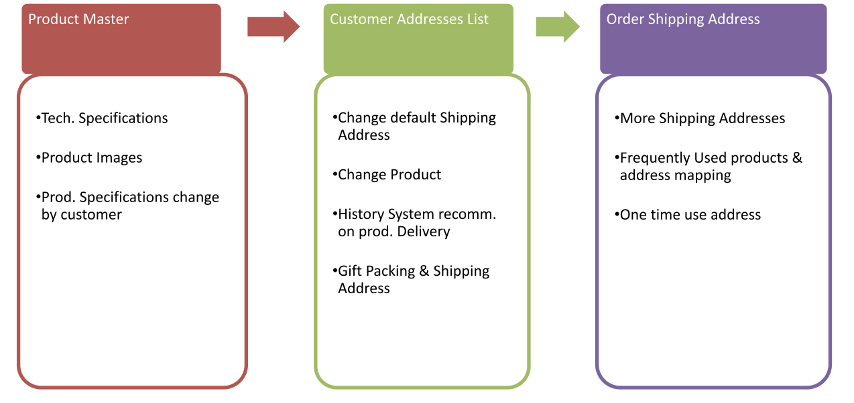
Suggested Solutions

Slide 12
NON FUNCTIONAL REQUIREMENTS
PERFORMANCE REQUIREMENTS
All canned reports should be published in < 10 seconds
All ad hoc reports should be published in < 5 seconds
Product Master screen should not take more than 2 sec to create a product
Customer Order screen should be able complete submission of customer order within 3 sec including all validations on shipping address.
Customer Address List screen should not take more than 2 sec
OPERATIONS AND RELIABVILITY
DISASTER RECOVERY REQUIREMENTS
PLATFORM REQUIREMENTS

Slide 13
TECHNICAL REQUIREMENTS
JAVA VIRTUAL MACHINE: Eclipse (Developing Application)
SPRINGBOOT (provide standalone platform)
MYSQL (Database handling)
MICROSERVICES (Creating multiple dedicated services)
POSTMAN (Testing Rest API)

Slide 14
CONLUSION
Our strategy is to enhance the profitability of GO through the implementation of a microservices architecture is a significant step towards achieving greater efficiency, scalability, and agility. By breaking down our application into small, loosely coupled, and independently deployable services, we can address specific pieces of functionality with precision and agility. This approach offers several benefits:
Efficiency
Scalability
Agility
Fault Isolation
Enhanced Customer Satisfaction

Slide 15
THANK YOU

